Slide 1
Top Tasks Classification
Designing an intuitive navigation
Notes:
Top Tasks Classification homepage

Slide 2
2021: In relation to the European Parliament select up to 5 things that are most important to you.
1. EU treaties, laws, rules, judgments
2. Implementation of EU law
3. Transparency, ethics, standards of conduct
4. Legislation impact (societal, country, economic)
5. Freedom of information, request access to documents
6. Parliament in session (plenary, live streaming, documents, votes)
7. Jobs, traineeships, volunteering at the European Parliament
8. Parliament powers (legislative, budgetary, scrutiny)
9. Legislative key priorities, themes, issues
TINY
TOP
SMALL
MEDIUM
Notes:
Tasks: Pie slices are based on count of votes

Slide 3
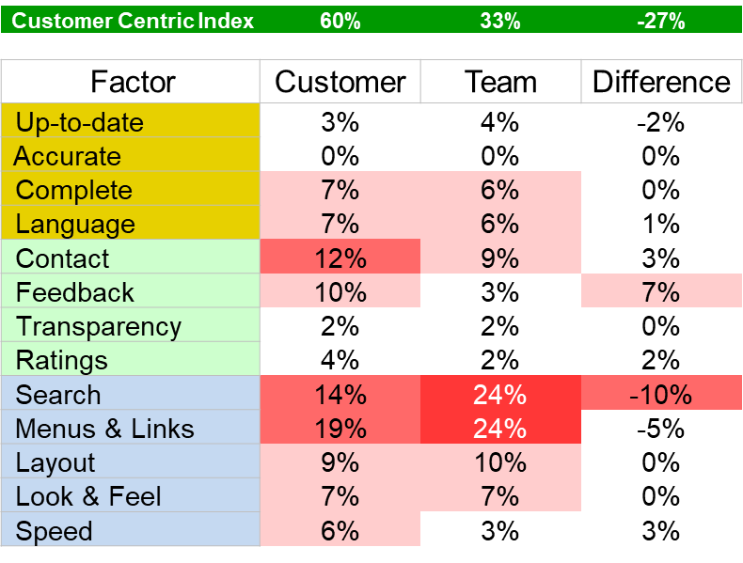
Action: Customer vs Team (internal) Comparison

Slide 4
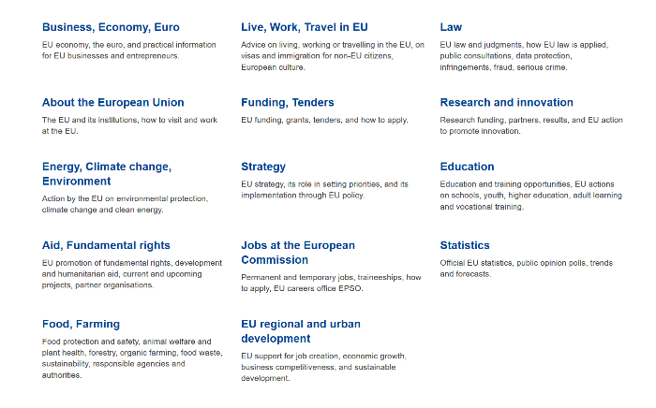

Slide 5
Top Tasks Classification
1. Top Tasks results
2. Sort
3. Classes
4. Task instructions
5. Three rounds of testing
6. 80-90% success

Slide 6
Transparency, ethics, standards of conduct
Freedom of information, request access to documents
Jobs, traineeships, volunteering at the European Parliament
Legislative key priorities, themes, issues
Advocacy, proposing new laws, amendments, ideas
Monitoring compliance of EU law
MEPs (profile, contact, activities)
News, announcements, press releases
European Parliament publications
European Union publications
Parliament in session (plenary, live streaming, documents, votes)
Parliament powers (legislative, budgetary, scrutiny)
European Parliament relationship with other EU institutions
EU treaties, laws, rules, judgments
Implementation of EU law
Legislation impact (societal, country, economic)

Slide 7
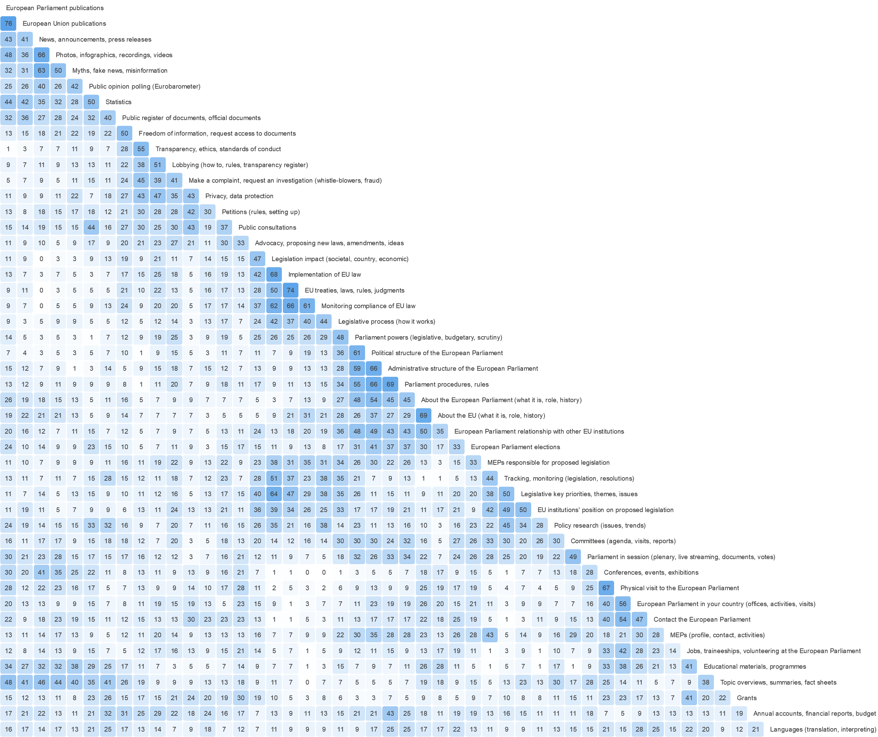

Slide 8
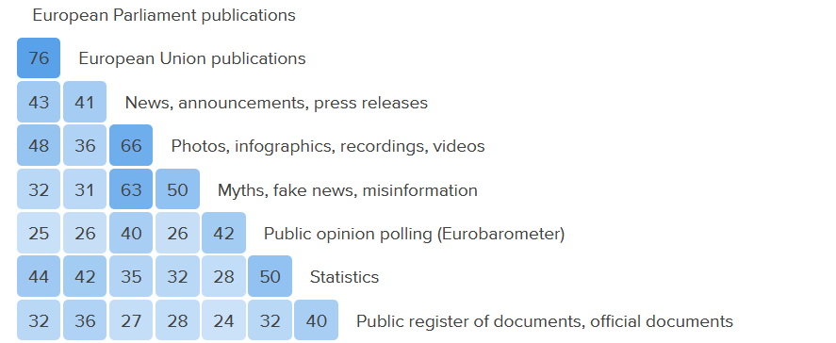

News
Topic overviews, summaries, fact sheets

Slide 9
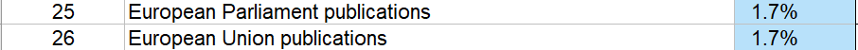
News & Publications?

Slide 10
Sorting best practice
  Complete Top Tasks identification.
  Top level first.
  Select around 30 tasks for the sort.
  Choose a sorting tool (Optimal Workshop)
  Include short survey
  Get minimum of 15 people to sort
  Present tasks in top tasks results order.
  Do not make it compulsory to sort everything.
  Do NOT make it compulsory to name groups.
  Agree on a hypothetical classification
  Everything gets classified

Slide 11
Hypothetical classification

Slide 12
Task instructions for testing

Slide 13
Submit a suggestion for a new regulation.

Slide 14
Top Task 11: Advocacy, proposing new laws, amendments, ideas
11: Submit a suggestion for a new regulation.

Slide 15
Classification testing best practice
  30 instructions
  15 people
  Avoid words that appear in classification
  Allow people to skip tasks

Slide 16
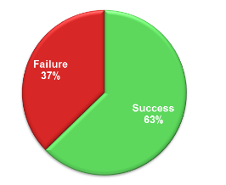
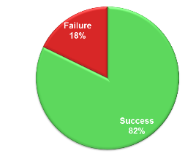
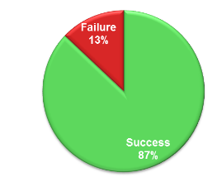
Typically, it takes three rounds of testing to get to an 80% - 90%overall success rate
1st test round
2nd test round
3rd test round

